Slide 1

LED Temperature Indicator
Asaf gabai
Lev (Arie) charfnadel

Slide 2
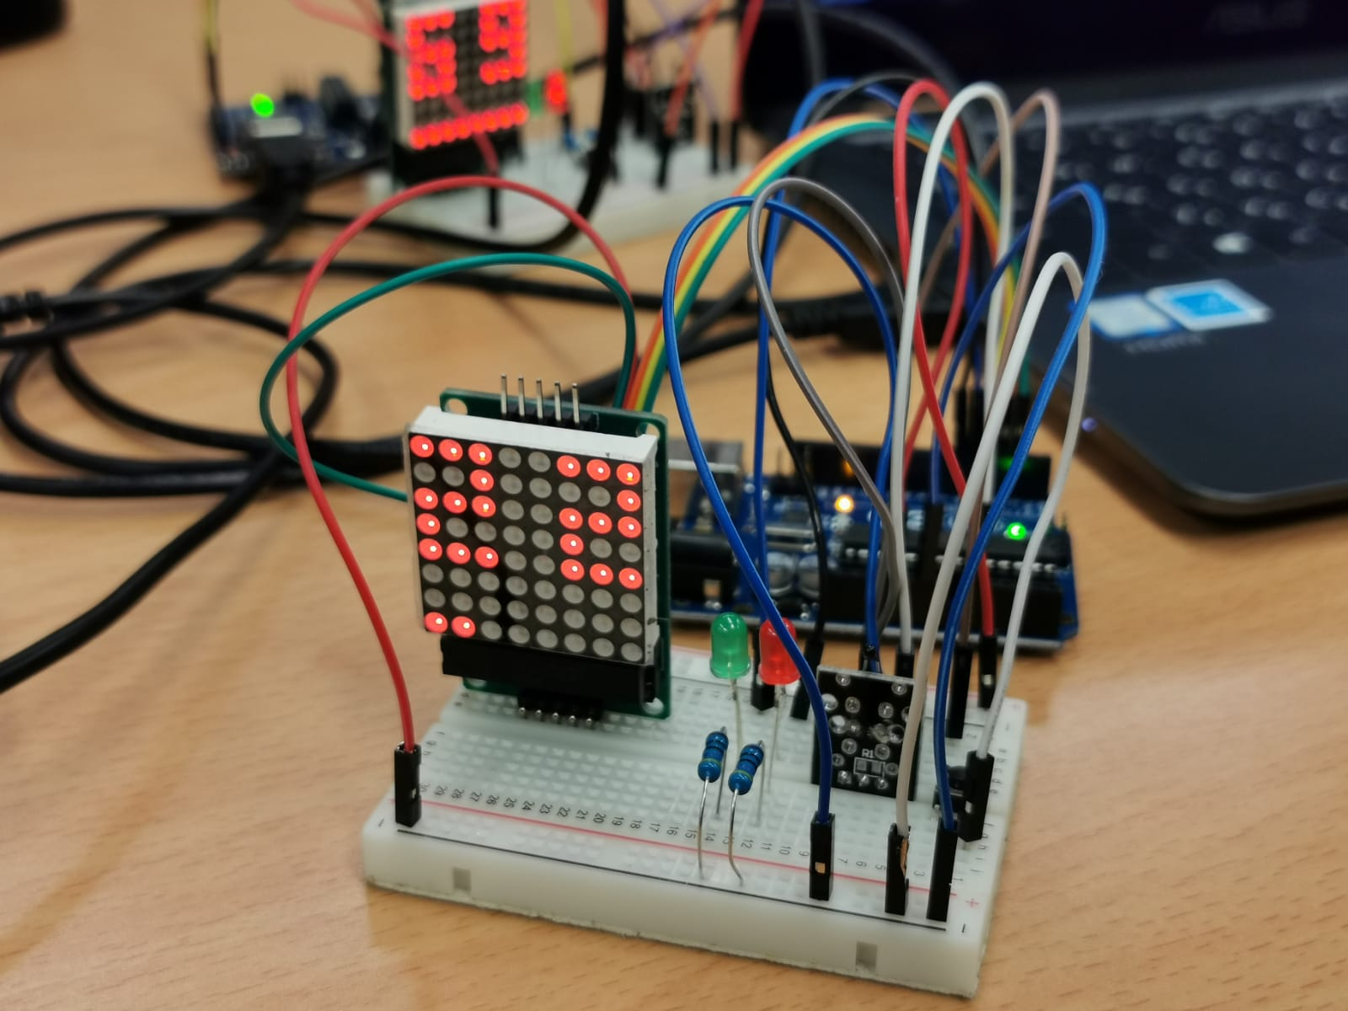
Implementation
Matrix display
Thermistor (connected to analog input pin)
Red and green LEDs connected in series to resistors (connected to digital input pins)
Push button (connected to a digital input pin)

Slide 3
Architecture
Initialization functions (variables and matrix display configuration)
Digits and symbols database (implemented using two-dimensional arrays)
Temperature measuring and calculation functions
Display functions (using the database and the measurements)

Slide 4
Difficulties during implementation
Initial setting of the matrix display took a lot of time
The thermistor chip connections were not as described by the manufacturer settings – the right connections were found by the lecturer

